Slide 1
Whim
Logo Design & Branding Exercise

Slide 2
Run of Show
Defining Whim
State of Design
Category Considerations
Inspiration
Concepts
Next Steps

Slide 3
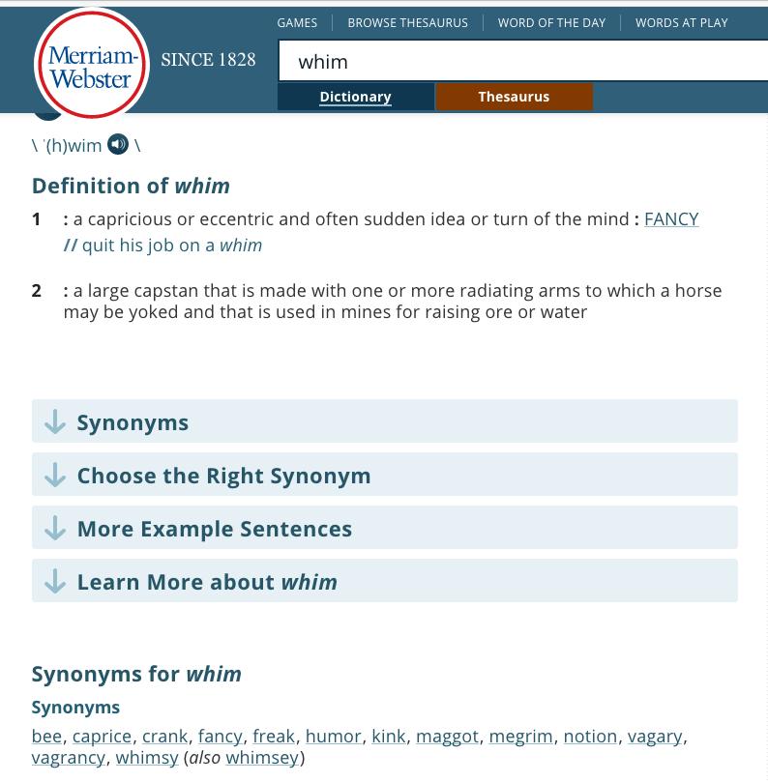
What is whim?
Webster says it involves high level thought that leads to and suggests quick turns in opinion or direction.
It’s another way to refer to the creative process.
It reeks of spontaneity, adventure and exploration.
It can be brilliant and maddening…but always entertaining

Slide 4
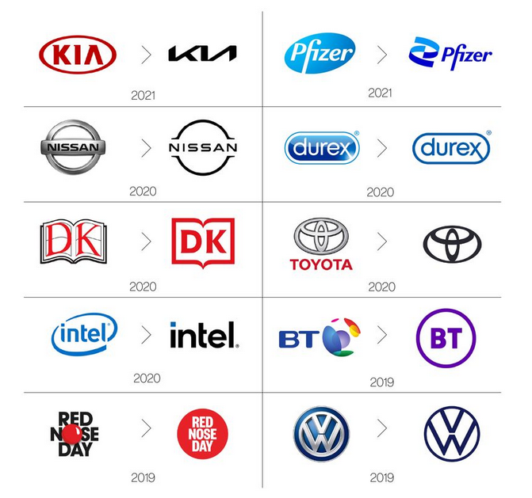
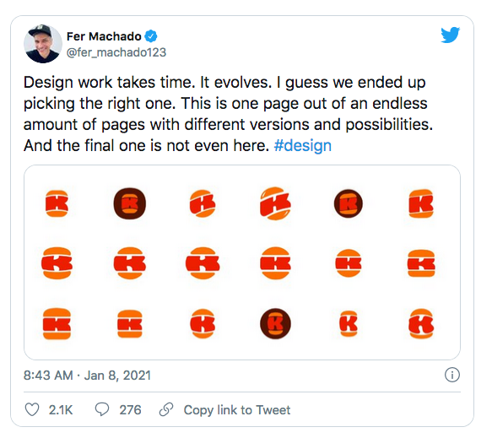
OK, but it’s just a logo design
And Picasso is just an artist.
It’s a marketing tool, first and foremost.
It can change and evolve over time as the business or organization does.
Current design trends suggest a “Debranding”
Read the article

Slide 5
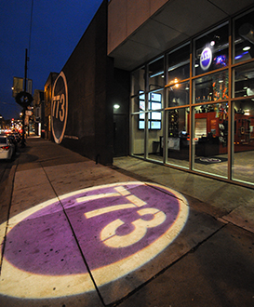
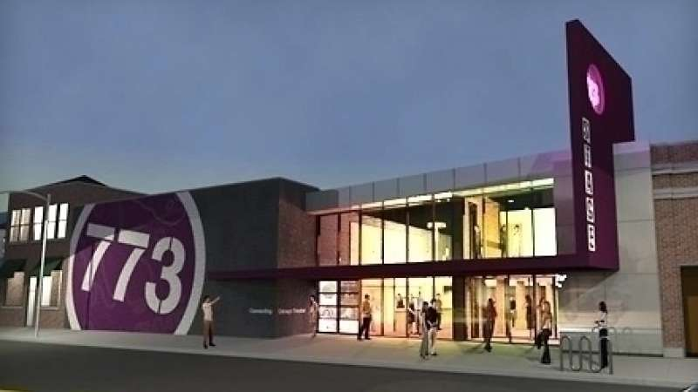
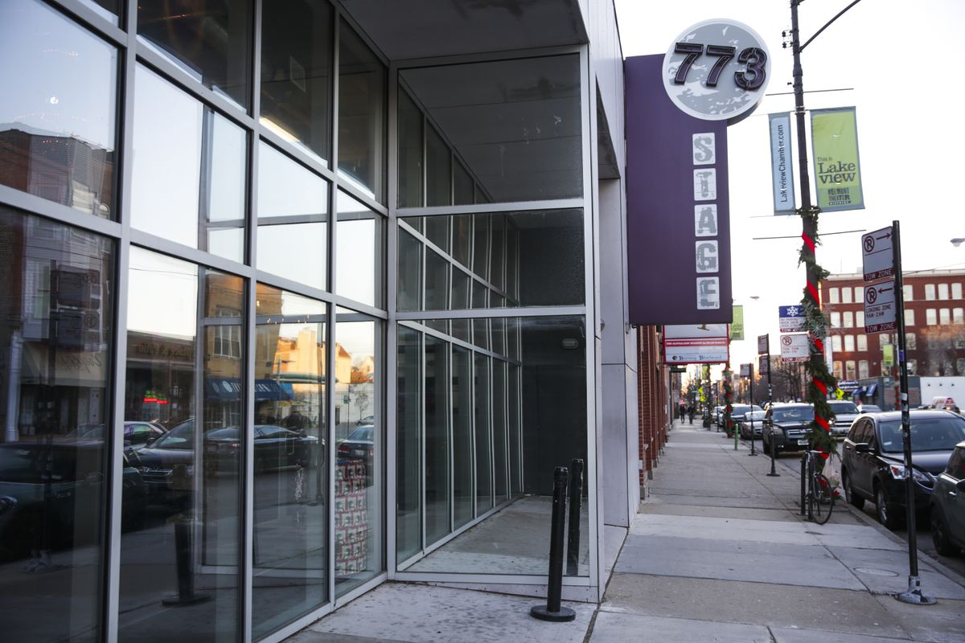
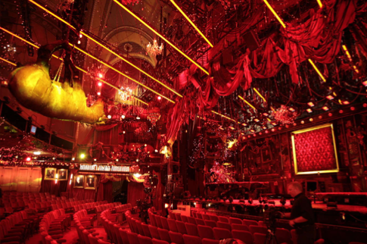
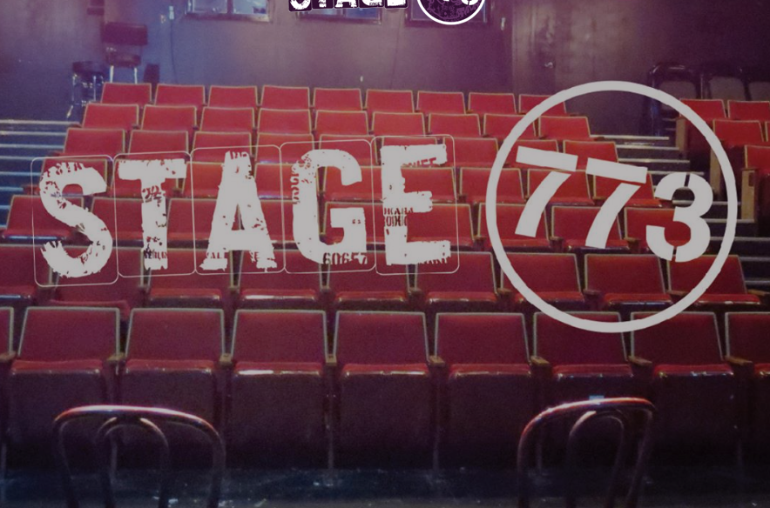
Consider the physical
In my creative process, it’s crucial to be mindful of the what, where and why of the subject being invented for.
For logos, they must represent the physical as well as the theoretical.
For Whim, we are an experience (what), a theatre building (where) and a cultural expression that inspires people’s life (why).
How do we properly apply to that?

Slide 6
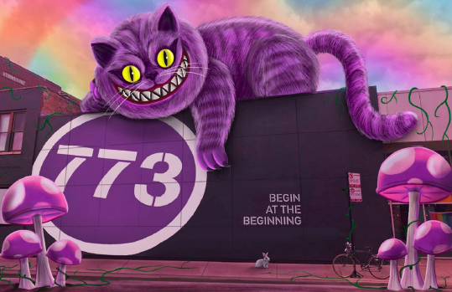
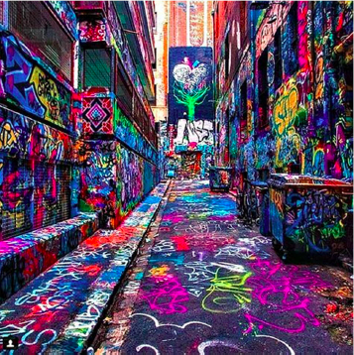
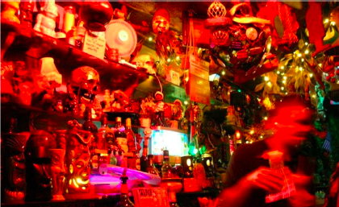
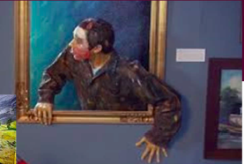
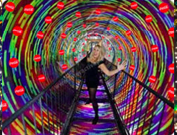
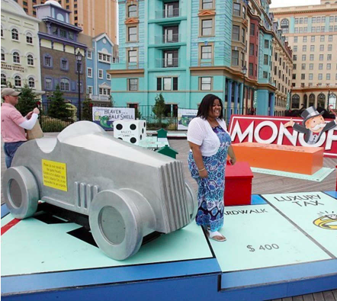
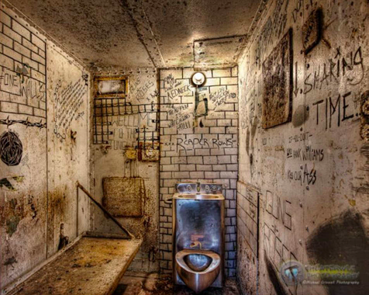
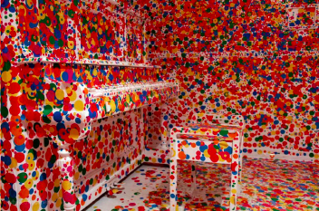
Inspiration
The core concept for this theatre and arts organization has been inspiration enough
Though…a bit messy

Slide 7
Concepts
Logo Mark
Colors, type, etc.
Examples of use

Slide 8
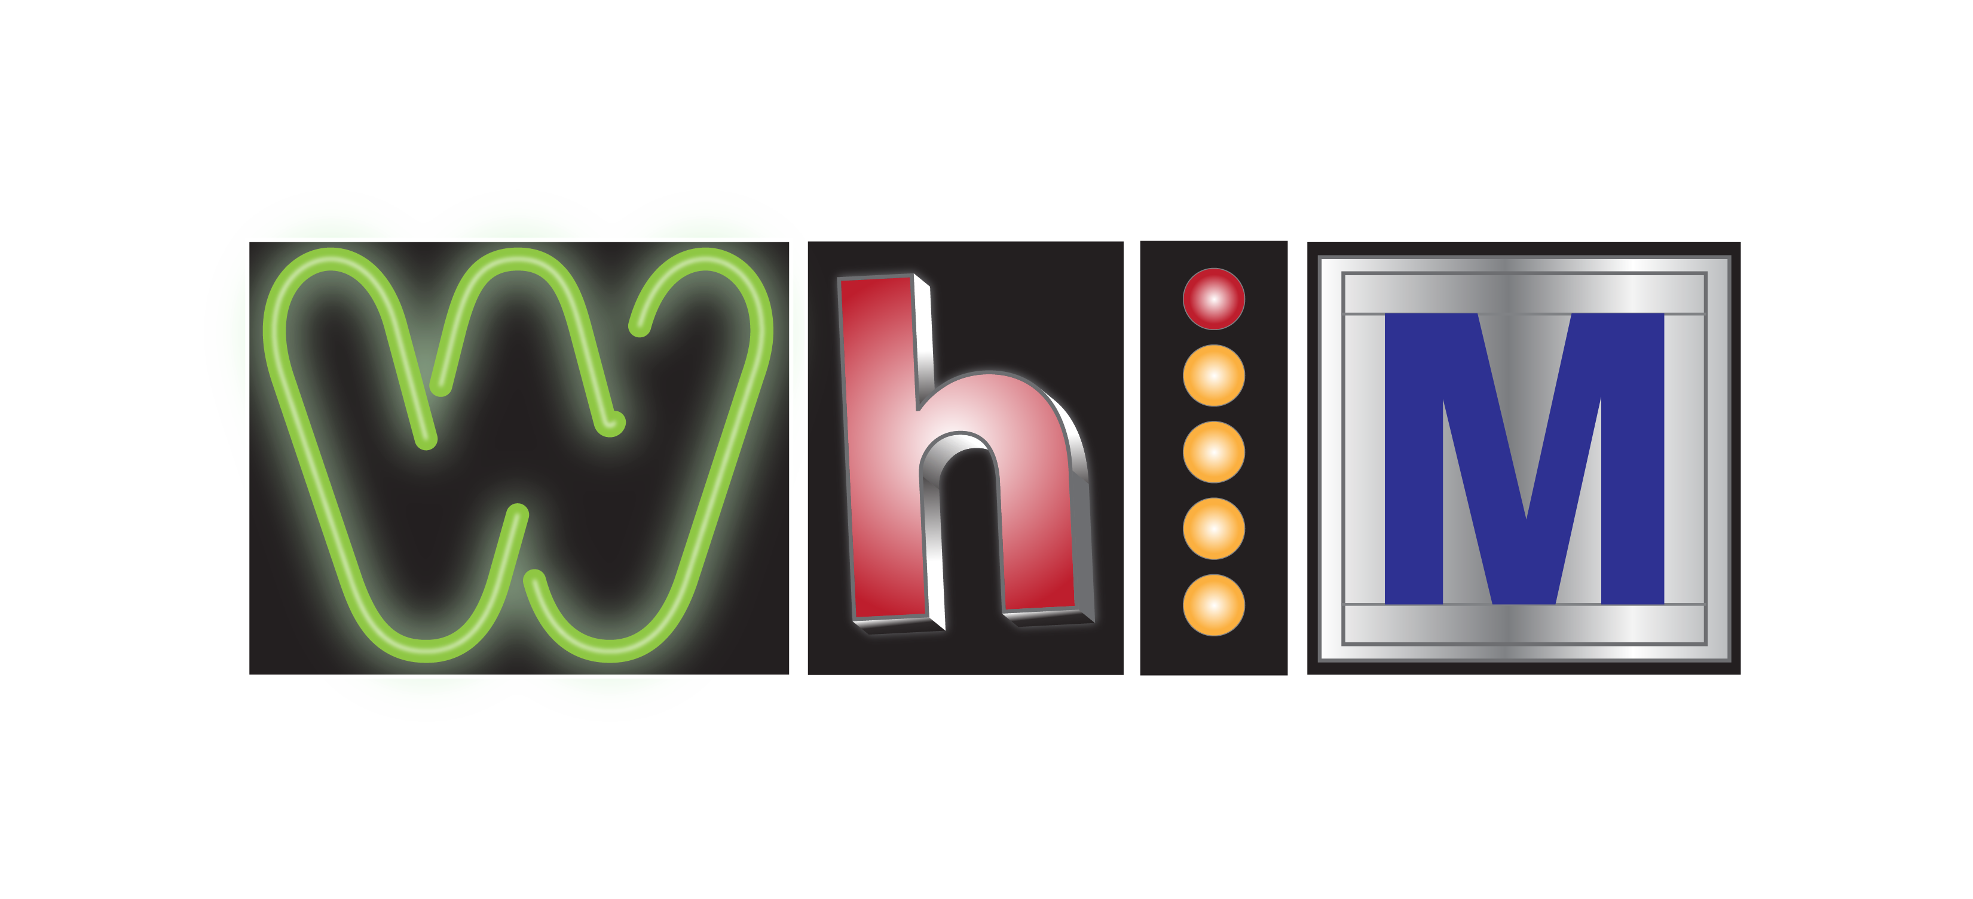
#1
Title: Lights
The variety of potential experiences suggest an avantgard approach to signage and the way that can manifest into the diversity of how someone thinks about entertainment prospects.
It feels somewhat random as if they cannot decide, constantly changing ones mind.
Various theatre lighting letters express this.

Slide 9
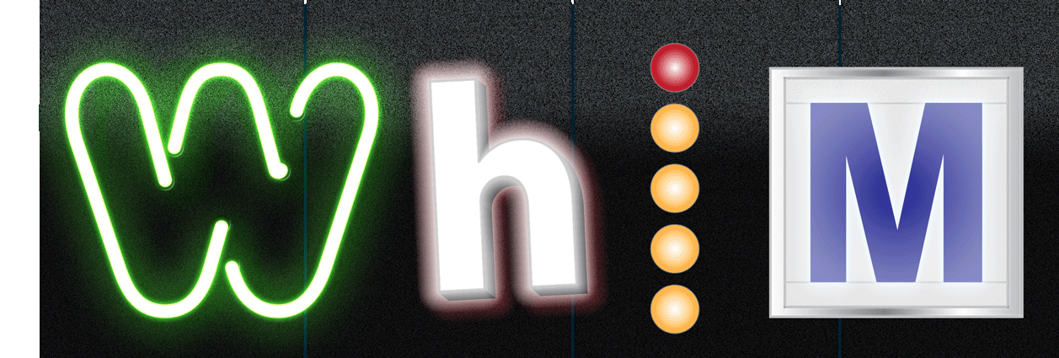

Slide 10
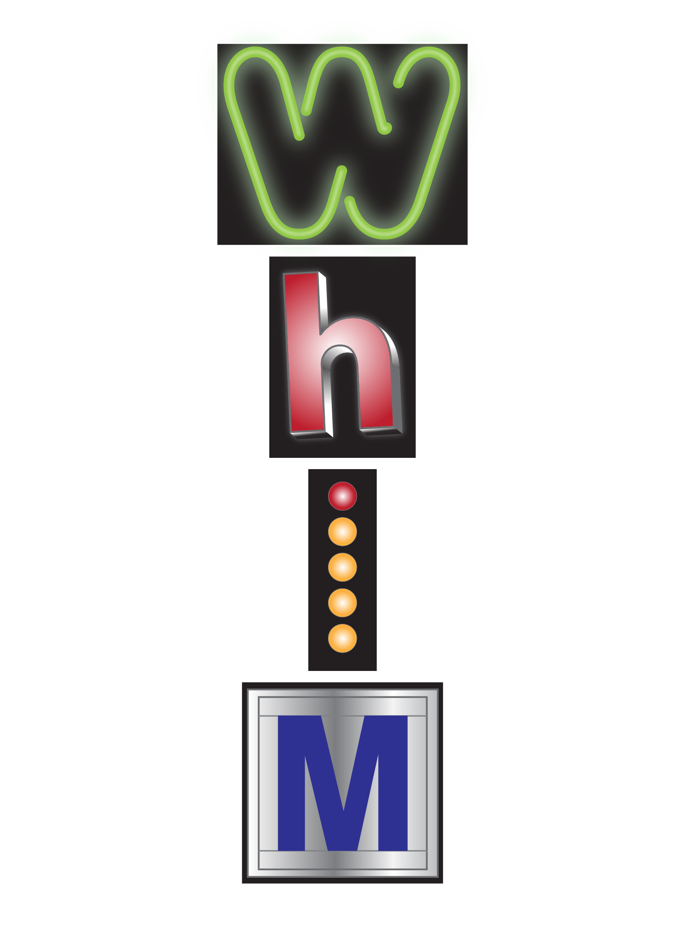
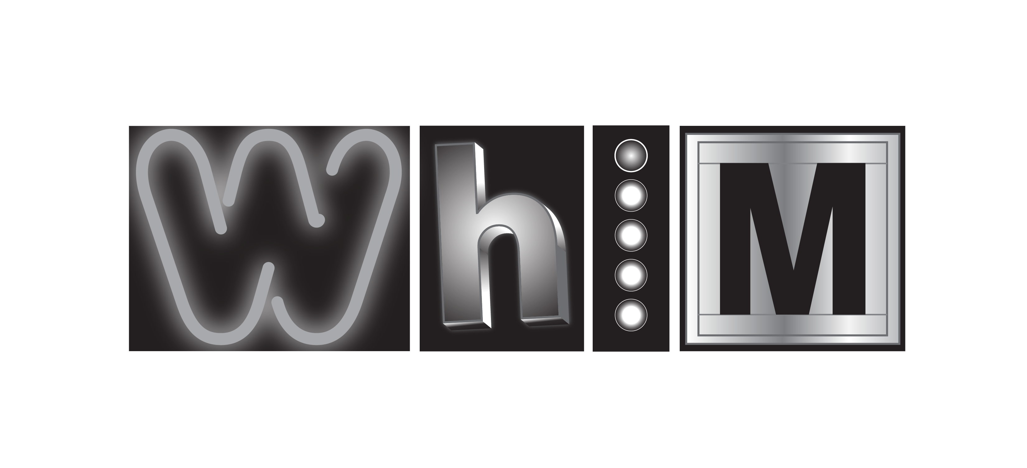
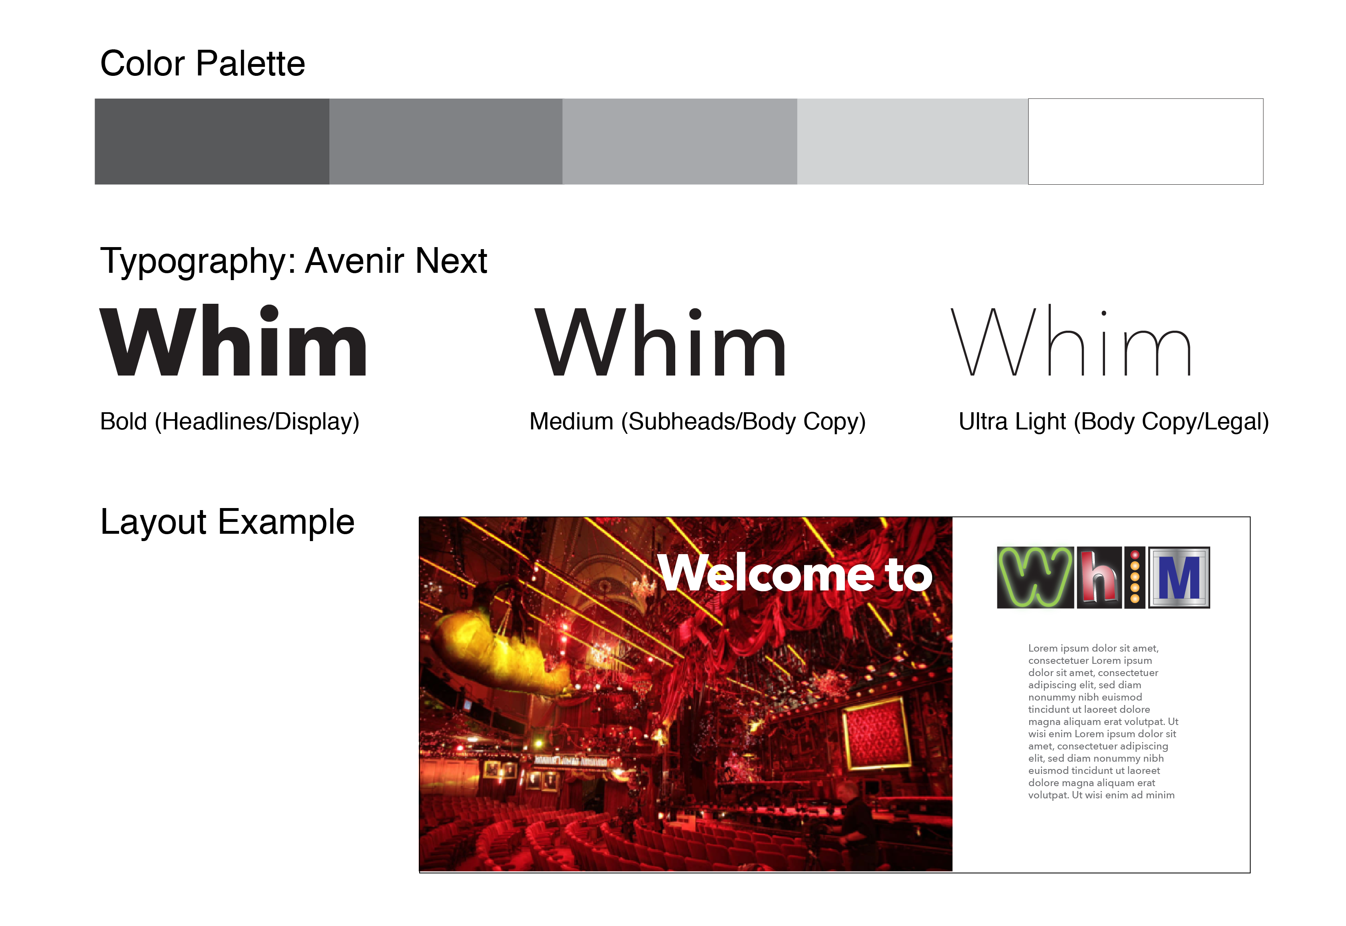
#1
Brand look
The simple neutral appearance allows us a sort of blank canvas for color imagery to stand out.
Dark spaces remind us of the absence of light and the promise of illumination.
Similar to a B&W that forces the viewer to focus on the actor’s emotion and dramatic lighting effects that sway the mindset.

Slide 11

#2
Title: Shapes
Basic geometric shapes are the building blocks for all things creative.
This design is a moving variety of possibilities where the logo itself could change randomly.
We have the ability here to make the viewer experience a Whim production as a point of entry.

Slide 12


Slide 13
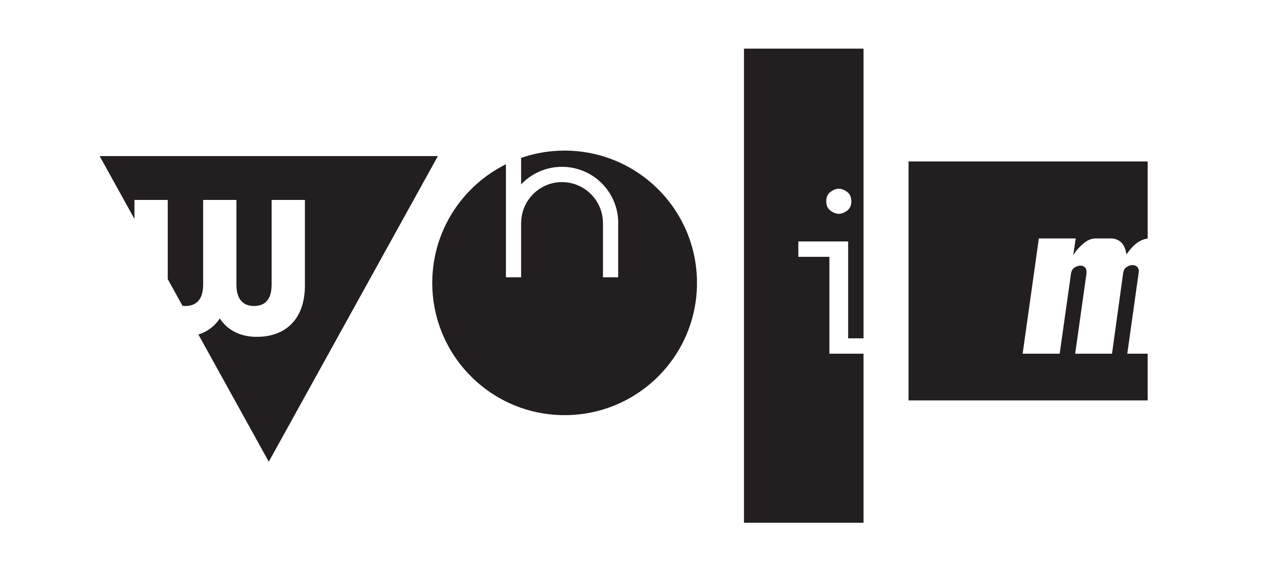
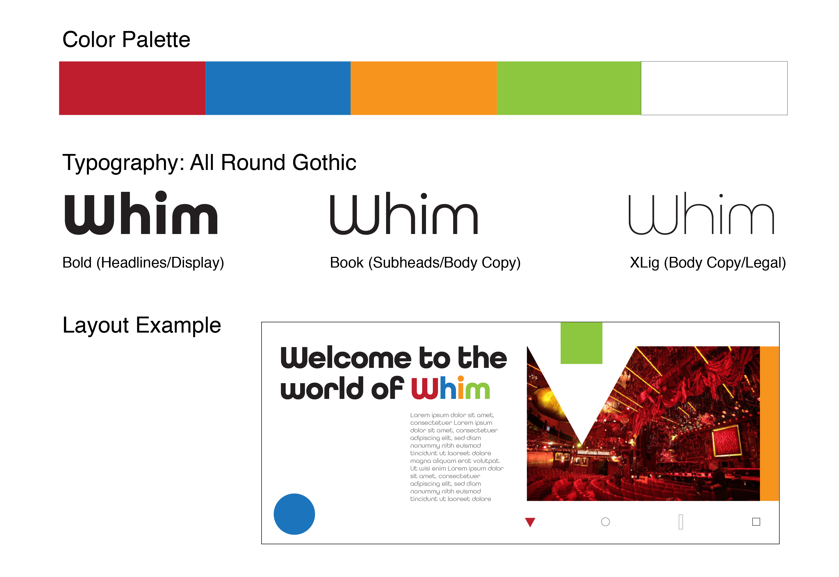
#2
Brand look
Multi primary and secondary colors bring life and vibrancy to the look.
The shapes can be used in interesting ways to interact with images, type, etc.
Typography look is happy and flexible with it’s roundness.

Slide 14
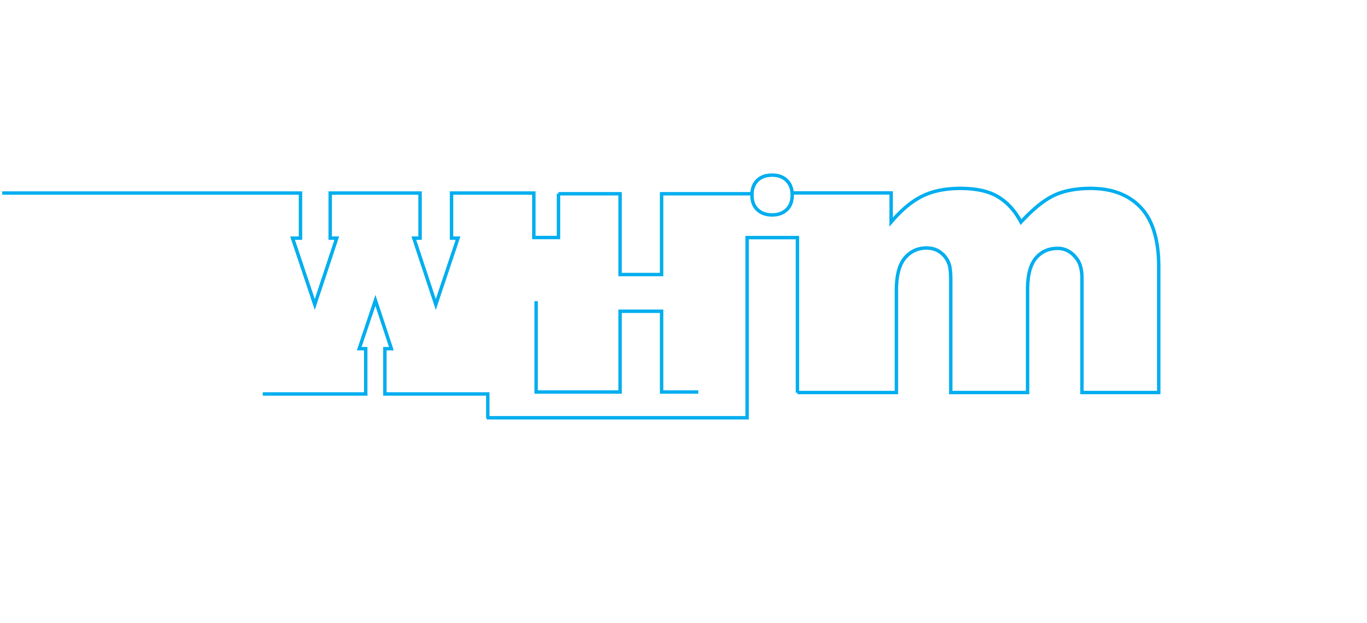
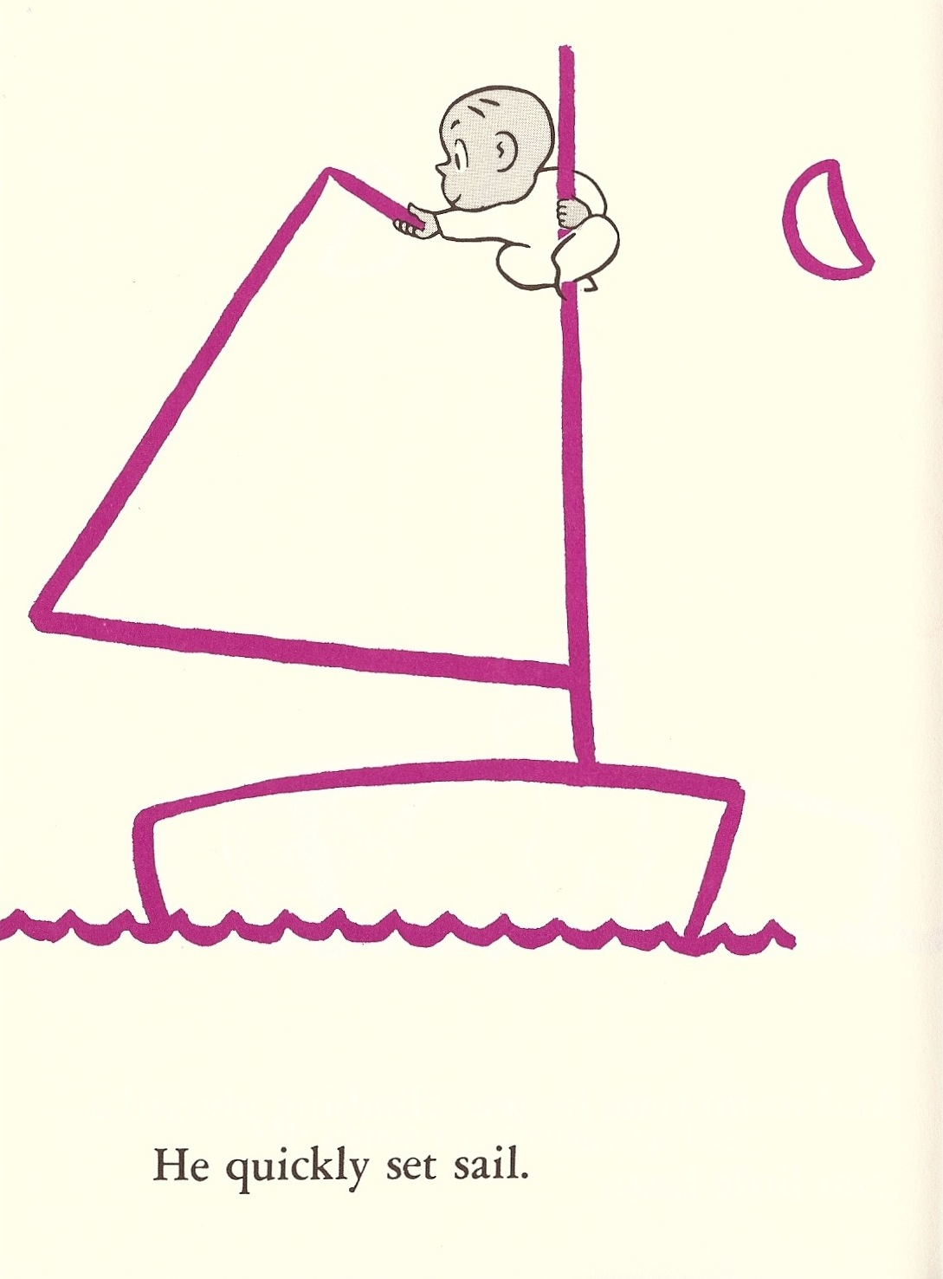
#3
Title: Line
Drawing is a starting point for most creative expression and concept development.
This logo can be a literal thread of discovery and intrigue with it’s almost incomplete, work-in-progress nature.
I see this as inviting invention as in the children’s book Harold and the Purple Crayon by Crockett Johnson

Slide 15
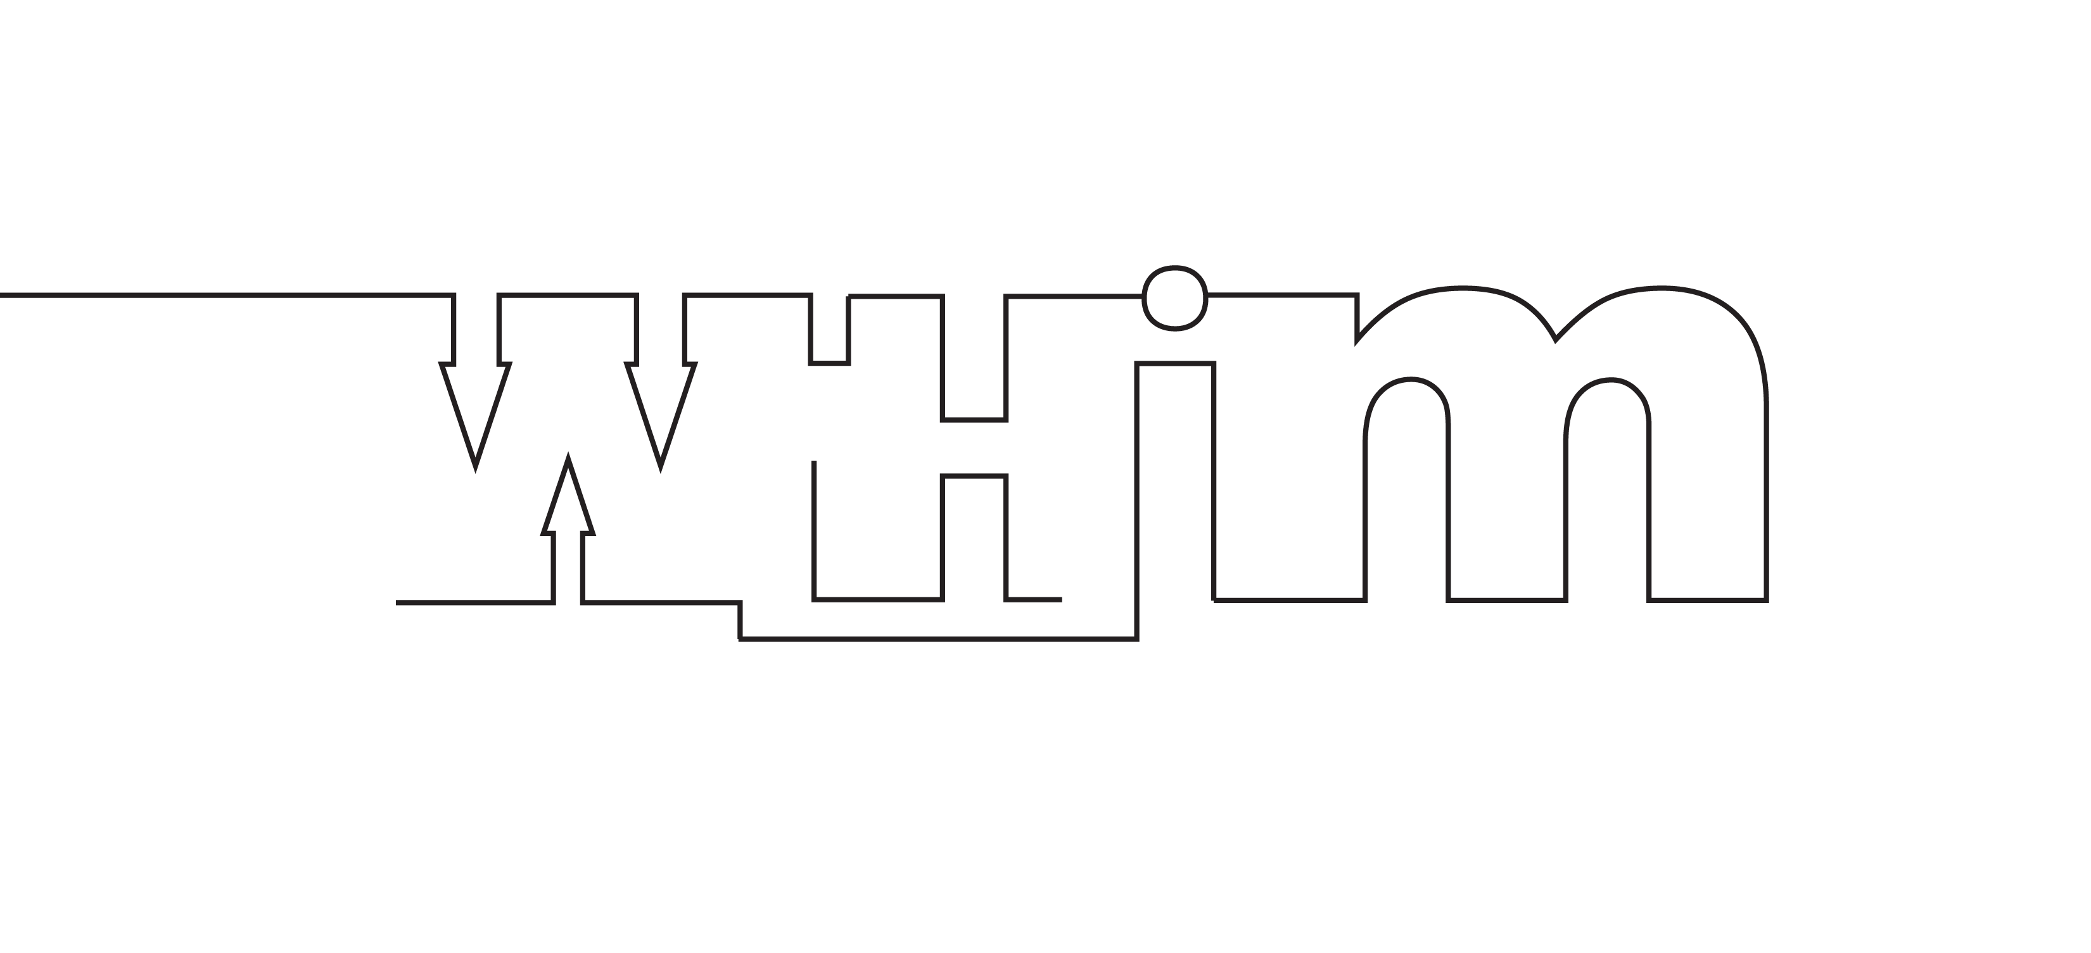
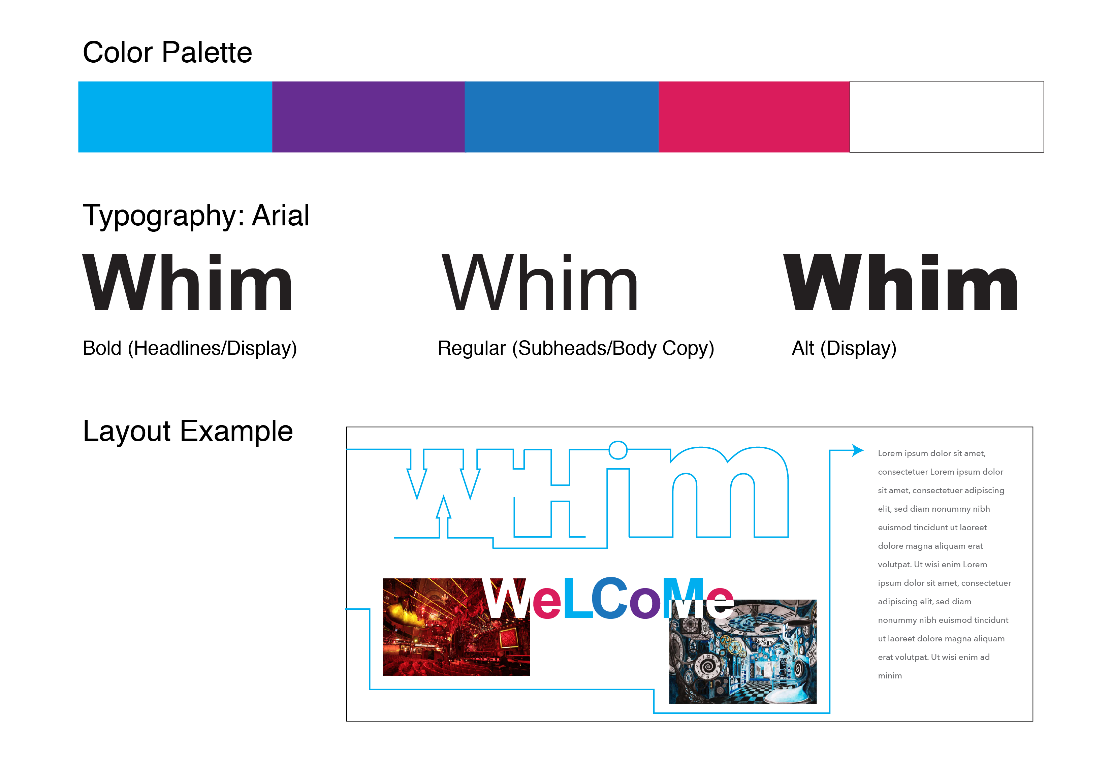
#3
Brand look
The play with line art as a directional to lead the viewers eye sets up the architecture in a given format.
The simple typography plays with upper and lower case in words and color to bring life to the communications.
Think linear motion as on-site way to show patrons thru the experience.

Slide 16
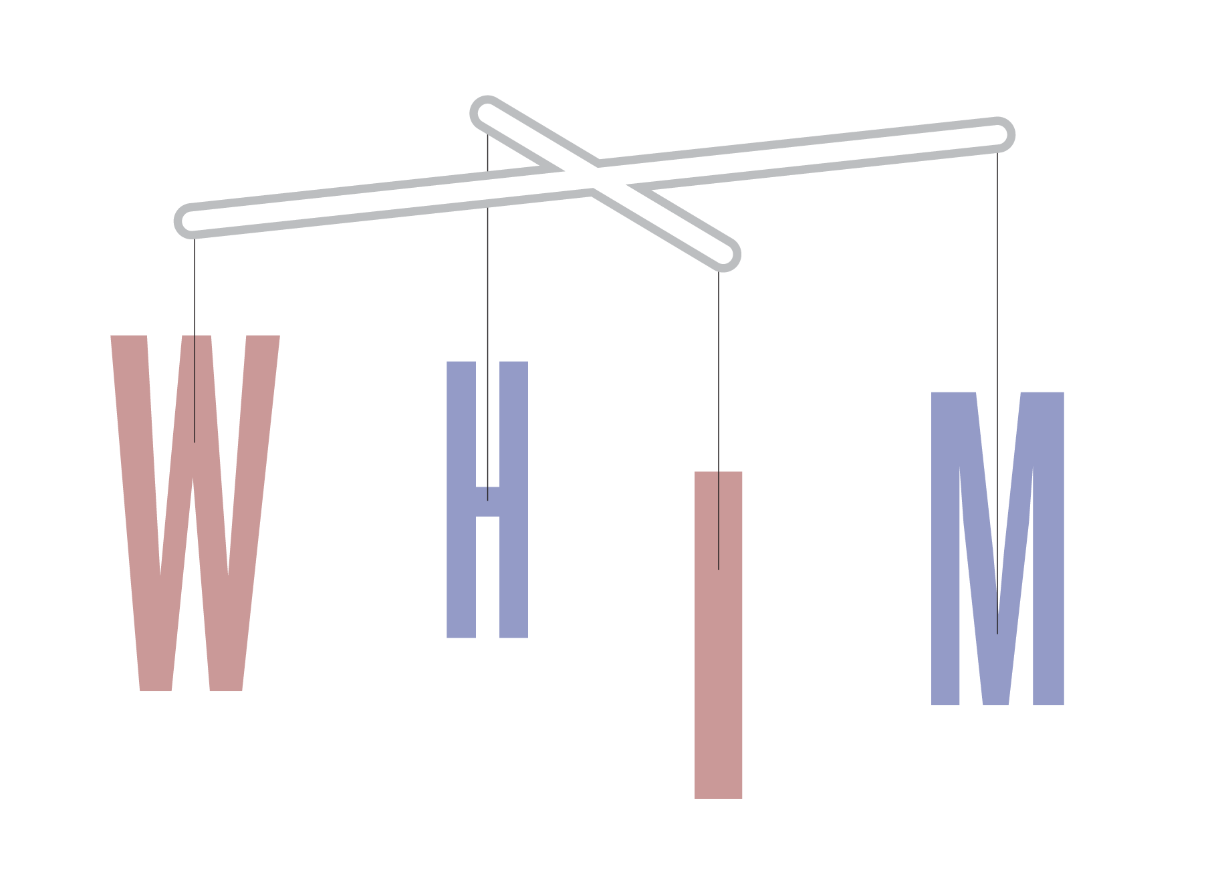
#4
Title: Mobile
Action and movement are suggested in this logo direction where angles of view change the way we see it.
Like a puppeteer who uses all his senses to make a character alive.
The physical uses of a mobile create a 3D moment indicative of the experience they are about to embark.

Slide 17
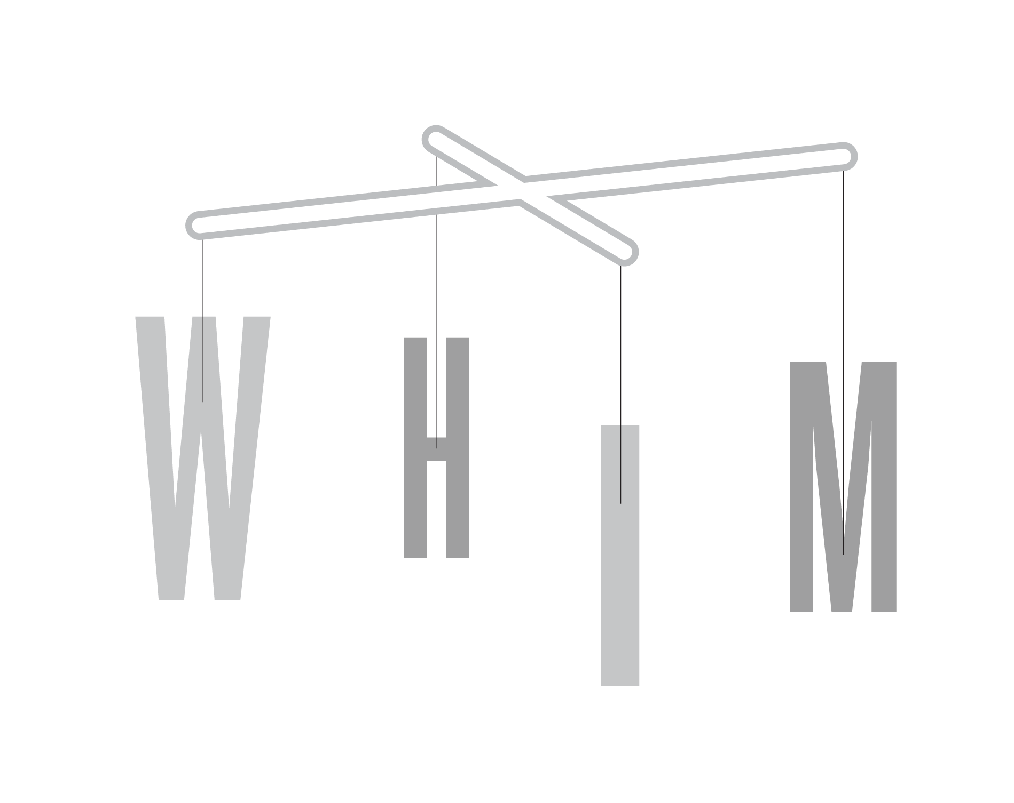
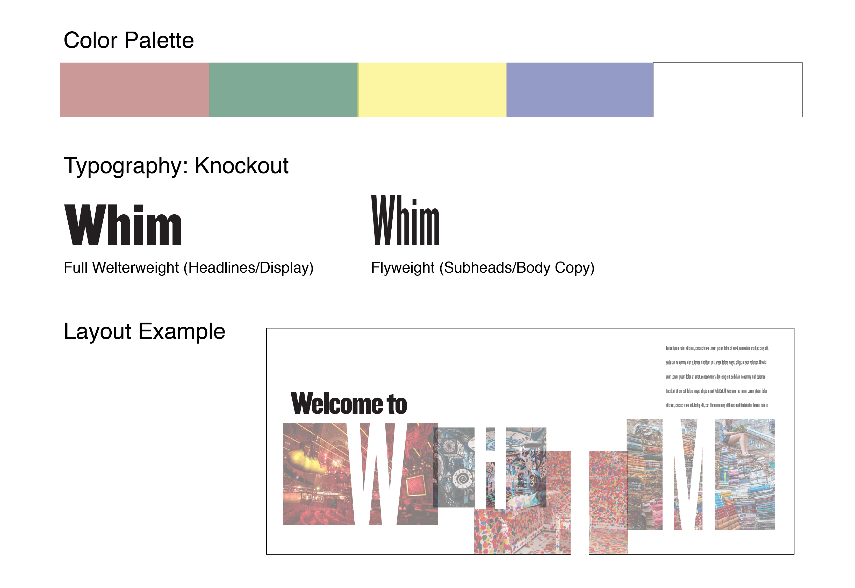
#4
Brand Look
Imbalance is the beauty of asymmetry in this design philosophy.
Lightened muted tones set up a breezy soft color palette.
Typography is classic mix of regular and condensed to suggest flexibility.

Slide 18
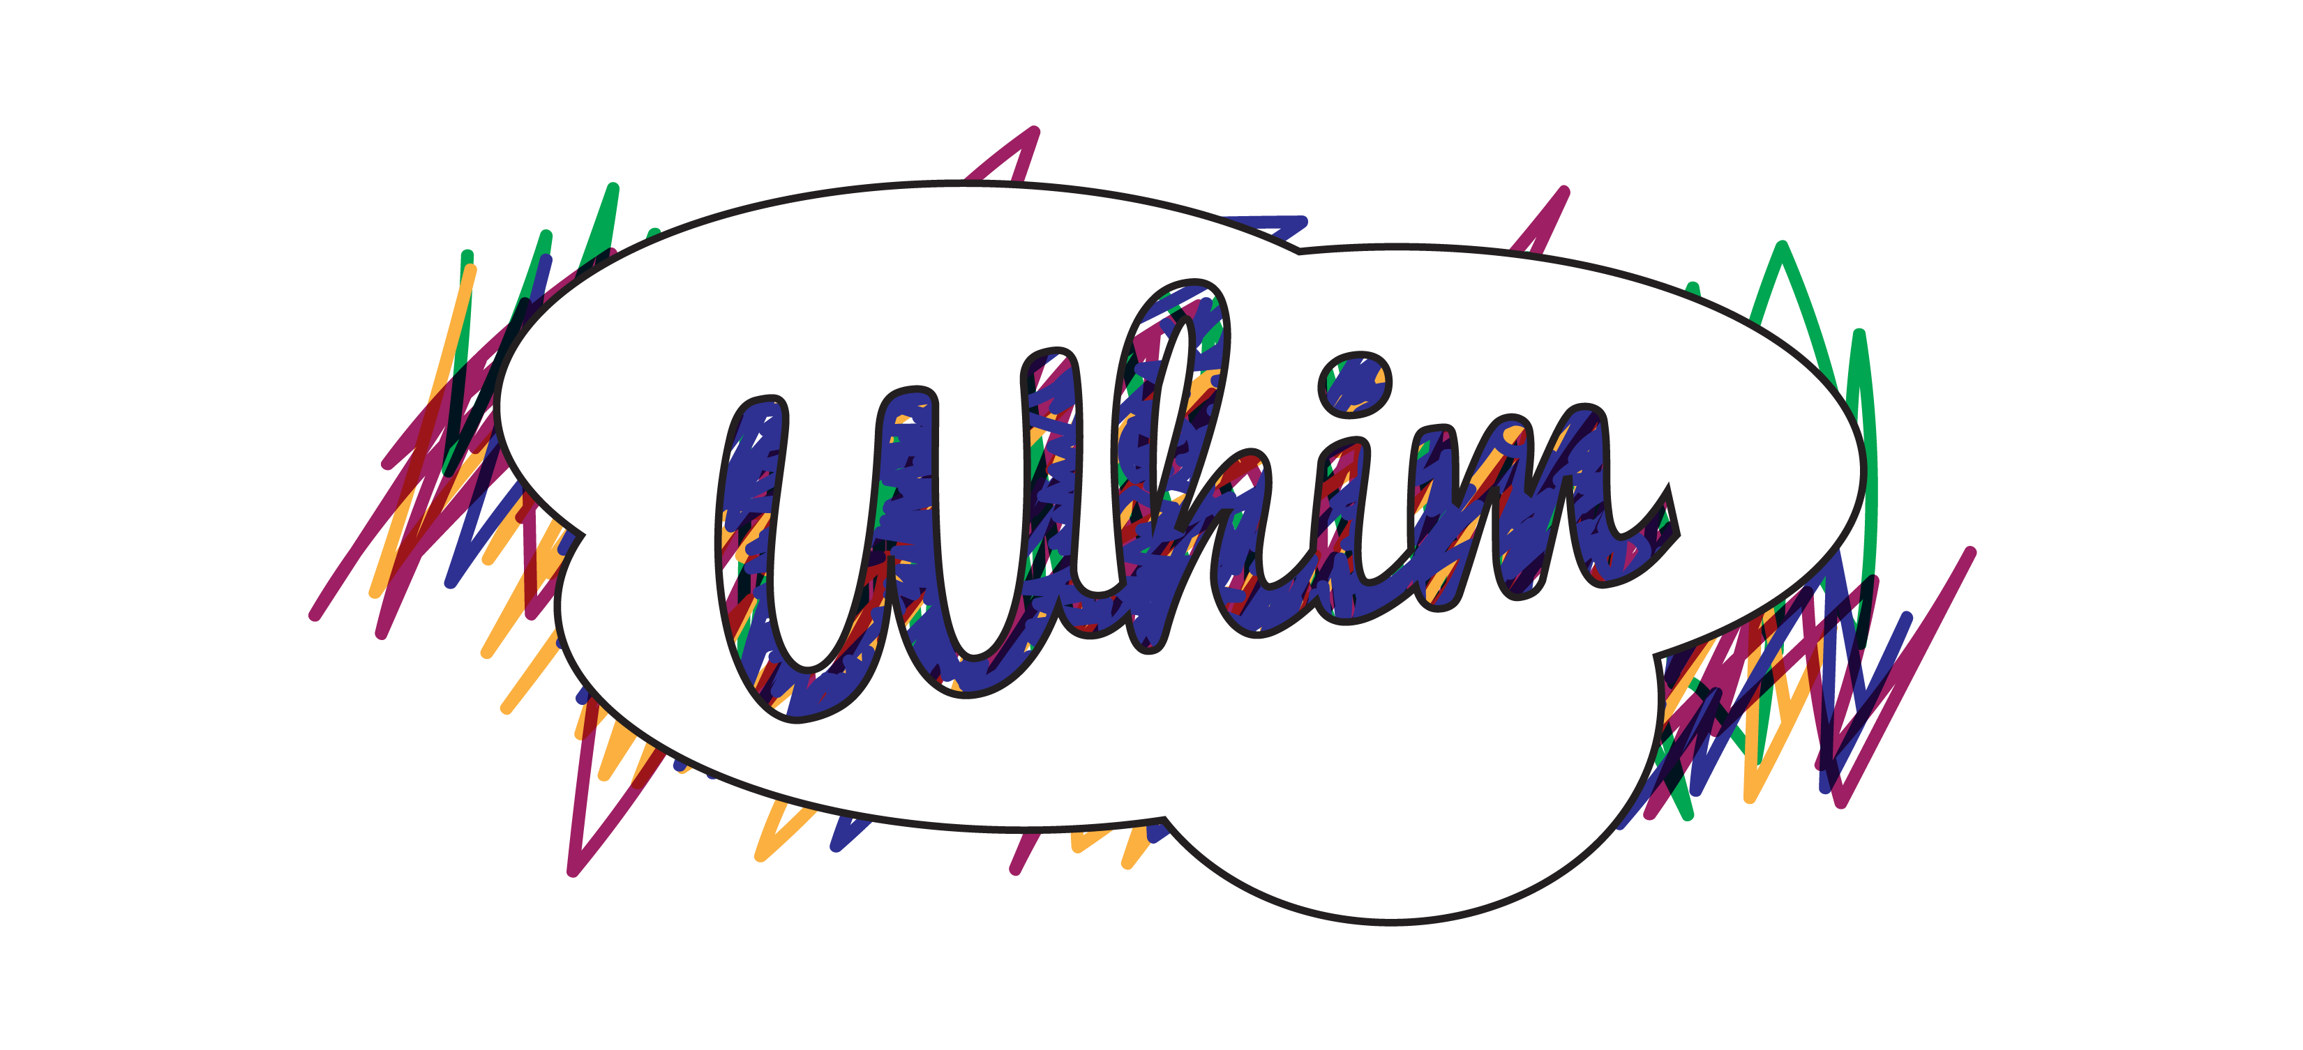
#5
Title: Scribble
A mess if color and artistic spirit fuel the bold statement of this logo.
There’s a child-like retro vibe that doesn’t stay within the lines.
Each day of performance a new sign is created with the previous one used for PR and fund raising efforts.

Slide 19
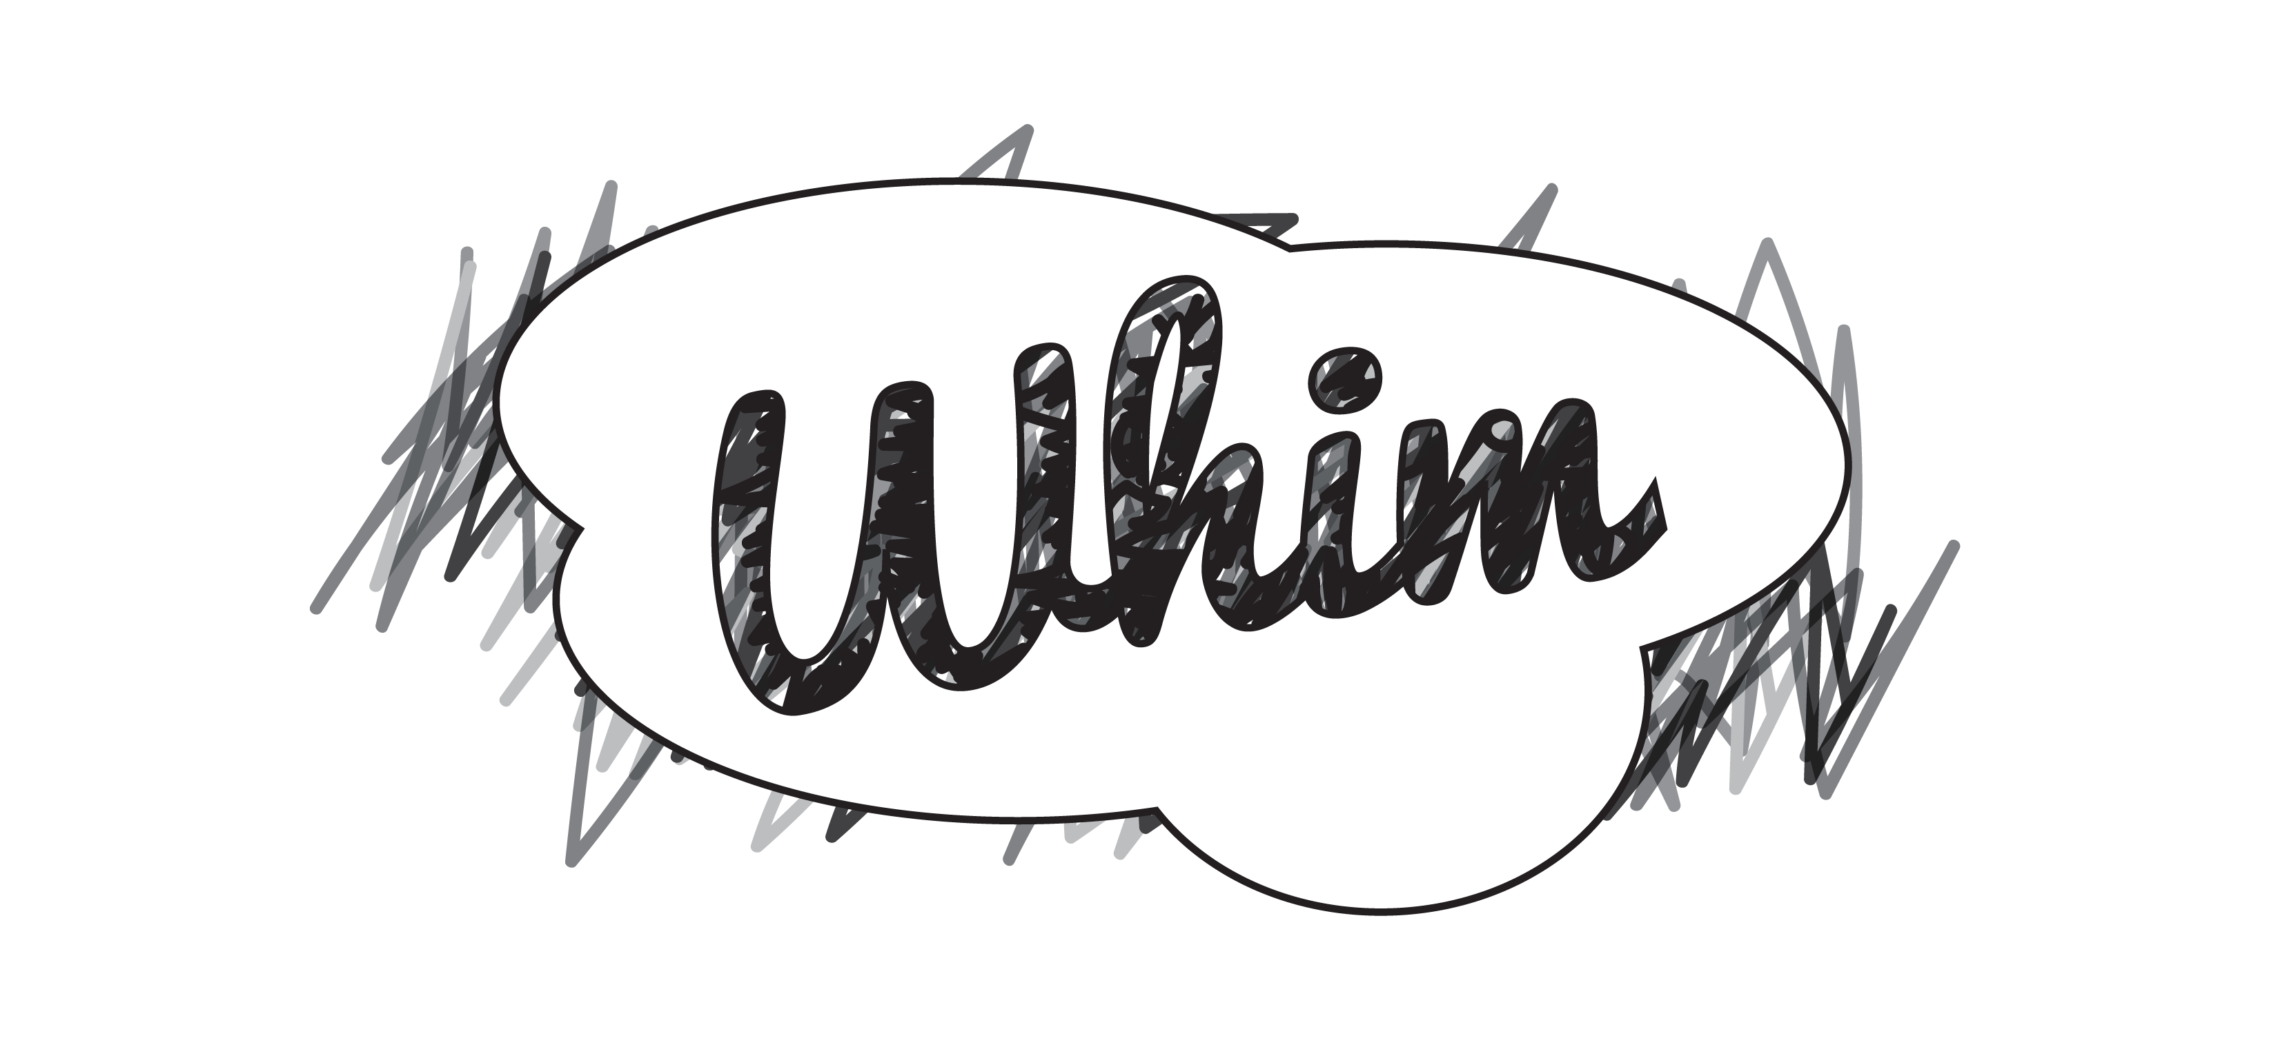
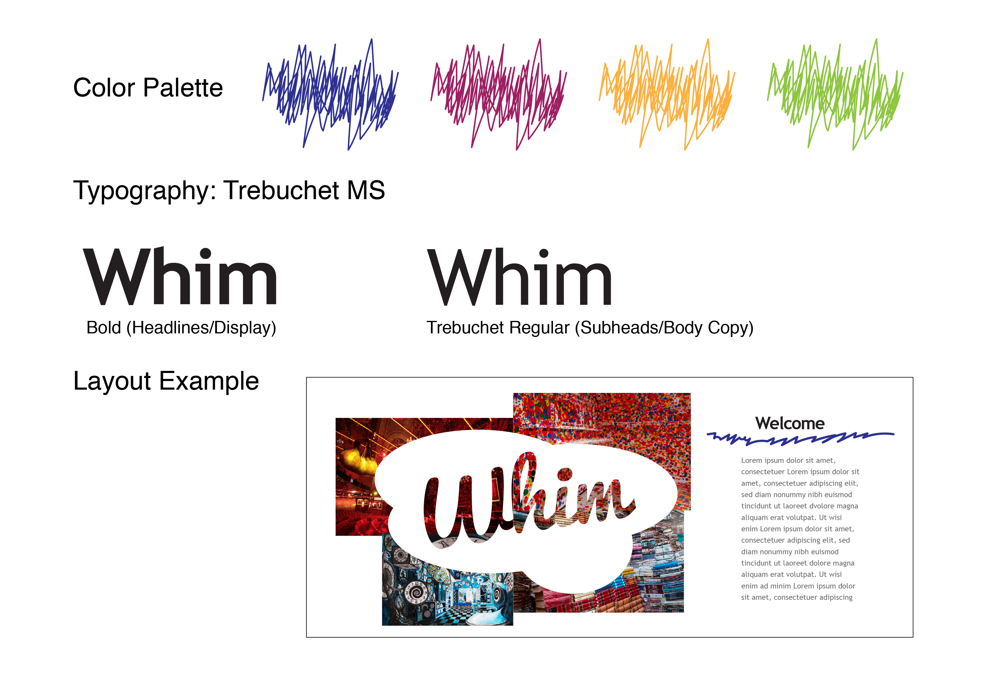
#5
Brand Look
Organized chaos defines the feeling one may get when seeing this material.
The artistic quality can be expanded upon, open to creativity for all.
Think stenciling for guerilla marketing.

Slide 20
Thank you for the opportunity
Next Steps are up to you…
petermonkcraig.com

